Slide 1
Identification of Low-Level Jets from AWAKEN Lidar Data
ATOC 5770 Final Project
Spring 2023
Alex Hirst

Slide 2



Motivation
Low-Level Jets (LLJs) have significant impacts on:
Moisture, pollutant, dust transport
Migratory animals
Wind farms!
Increased output
Increased wear
Understanding LLJ climatology in different regions will inform wind farm development and reduce cost

Slide 3
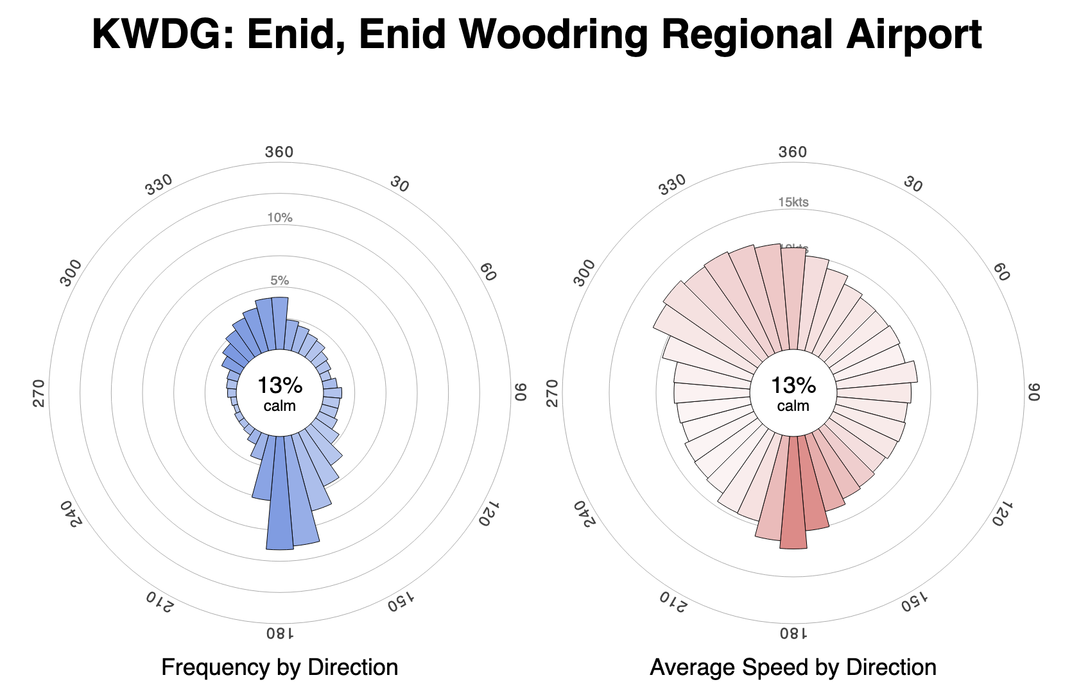
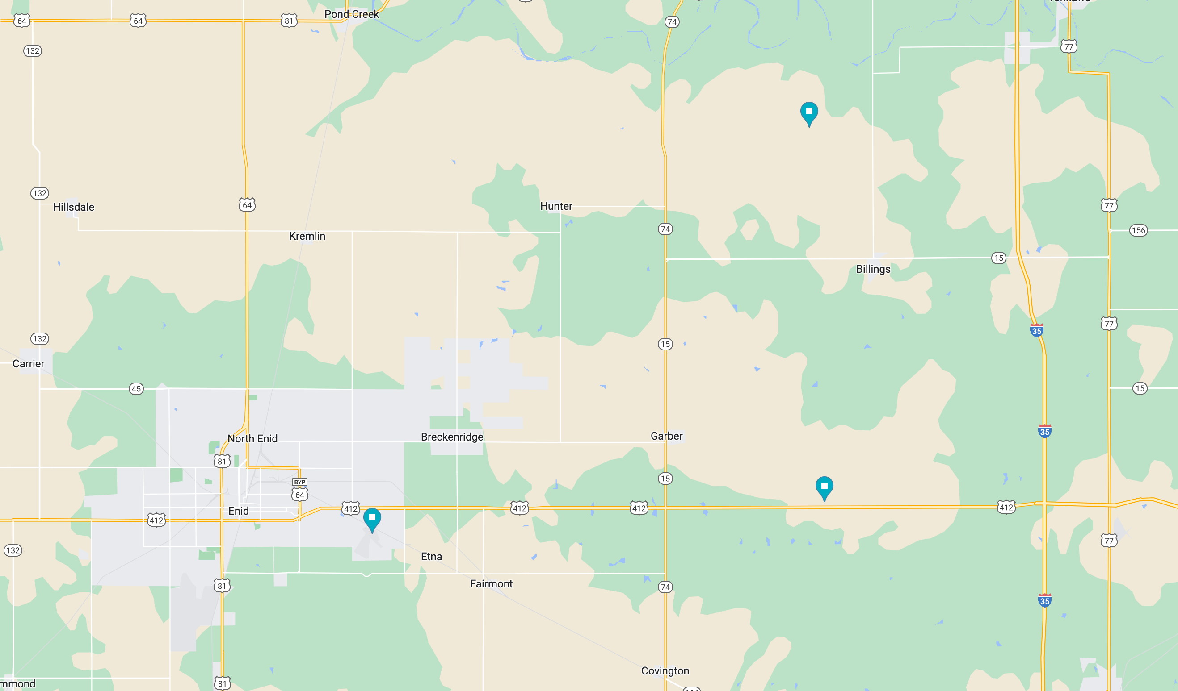
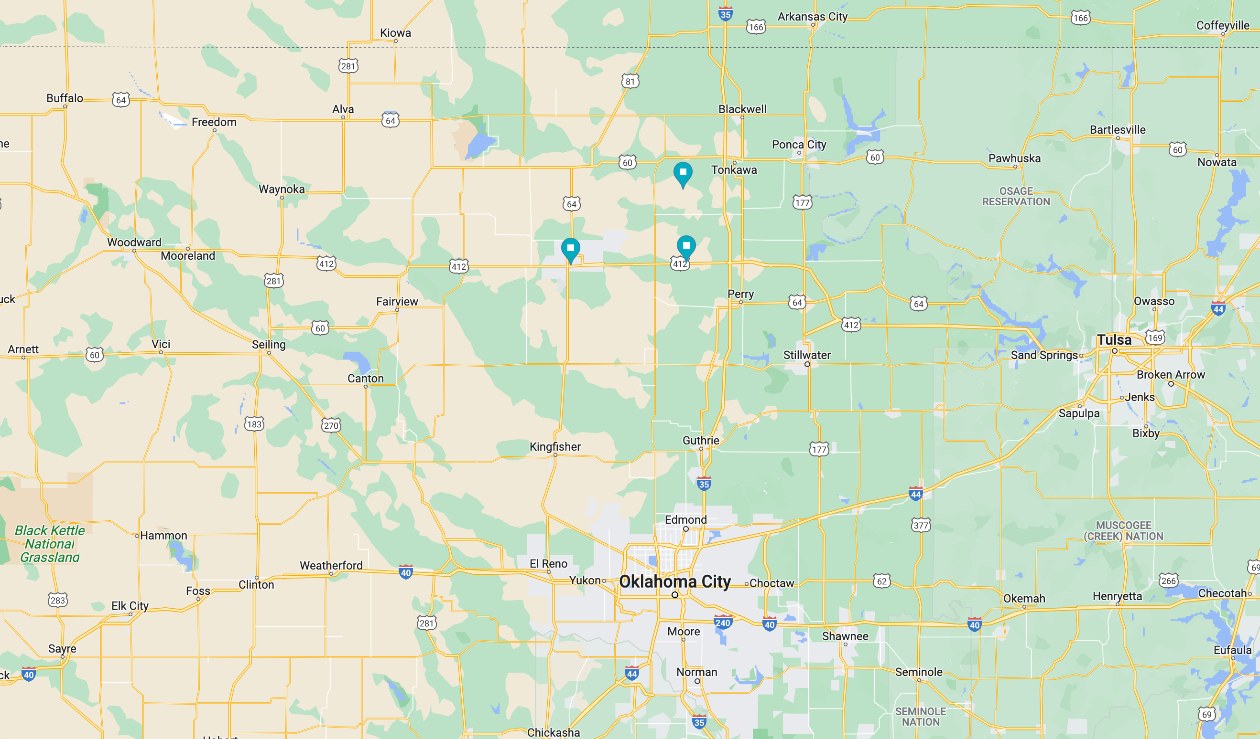
SGP - CART
~13 miles
~17 miles
King Plains (Site H)
KWDG
Close to SGP-CART facility, where extensive LLJ climatology studies have been conducted previously (Whiteman et al., 1997).

Slide 4
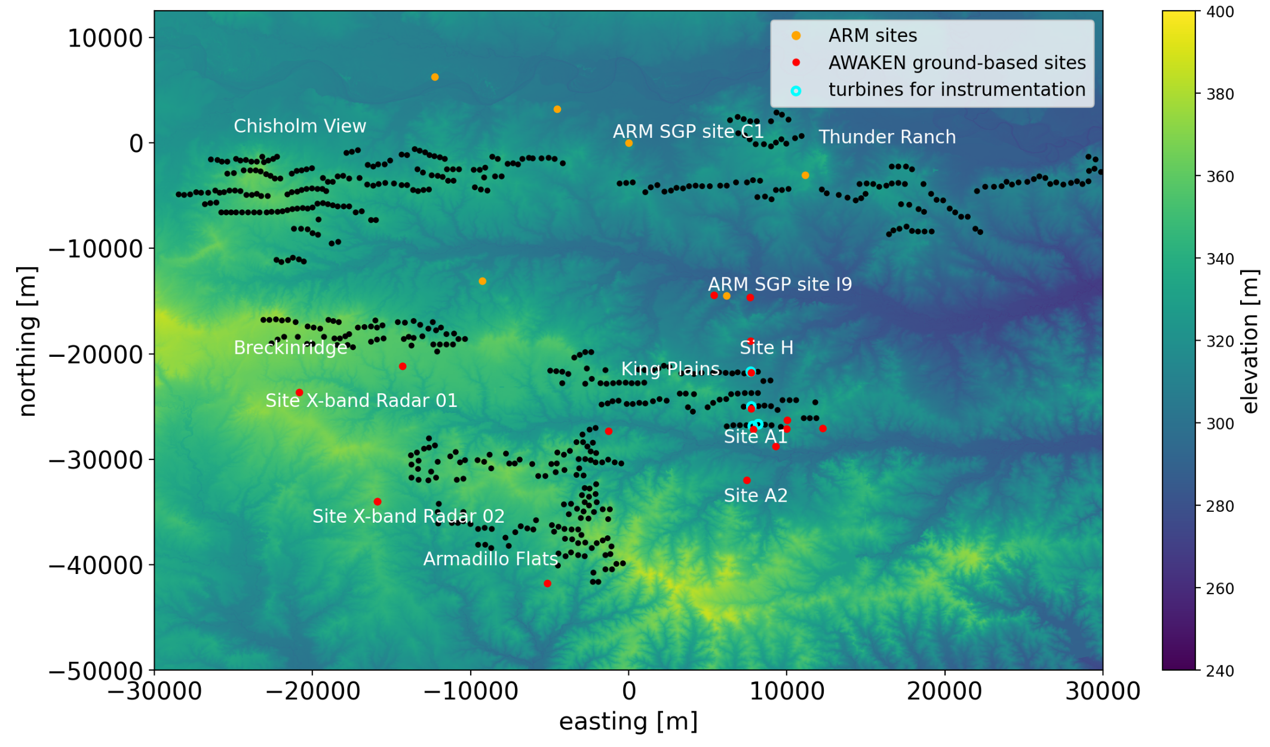
AWAKEN – Site H
(Debnath et al., 2022)

Slide 5
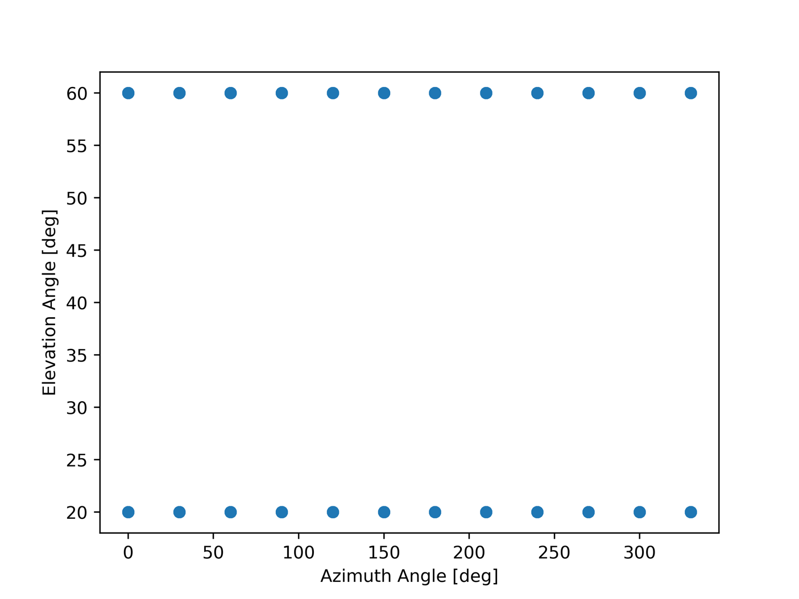
Lidar Dataset
“b1”-stage processed lidar data between Nov. 9 – Nov. 17 2022
Link to A2E website
30 minute measurement intervals
Measurements of radial velocity at:
Elevation angle in {20, 60} [deg]
Azimuth angle in {0, 30, 60, …, 330} [deg]
Radial distance in {15, 45, …, 9975} [m]

Slide 6
Identifying LLJs from Lidar Data
Process involves 3 steps (Vanderwende et al., 2015). :
Initial quality assurance of wind speed and direction measurements at each altitude bin
Calculation of wind speed and direction profiles from the Lidar radial velocity measurements
Identification and classification of LLJs from wind speed profiles.

Slide 7
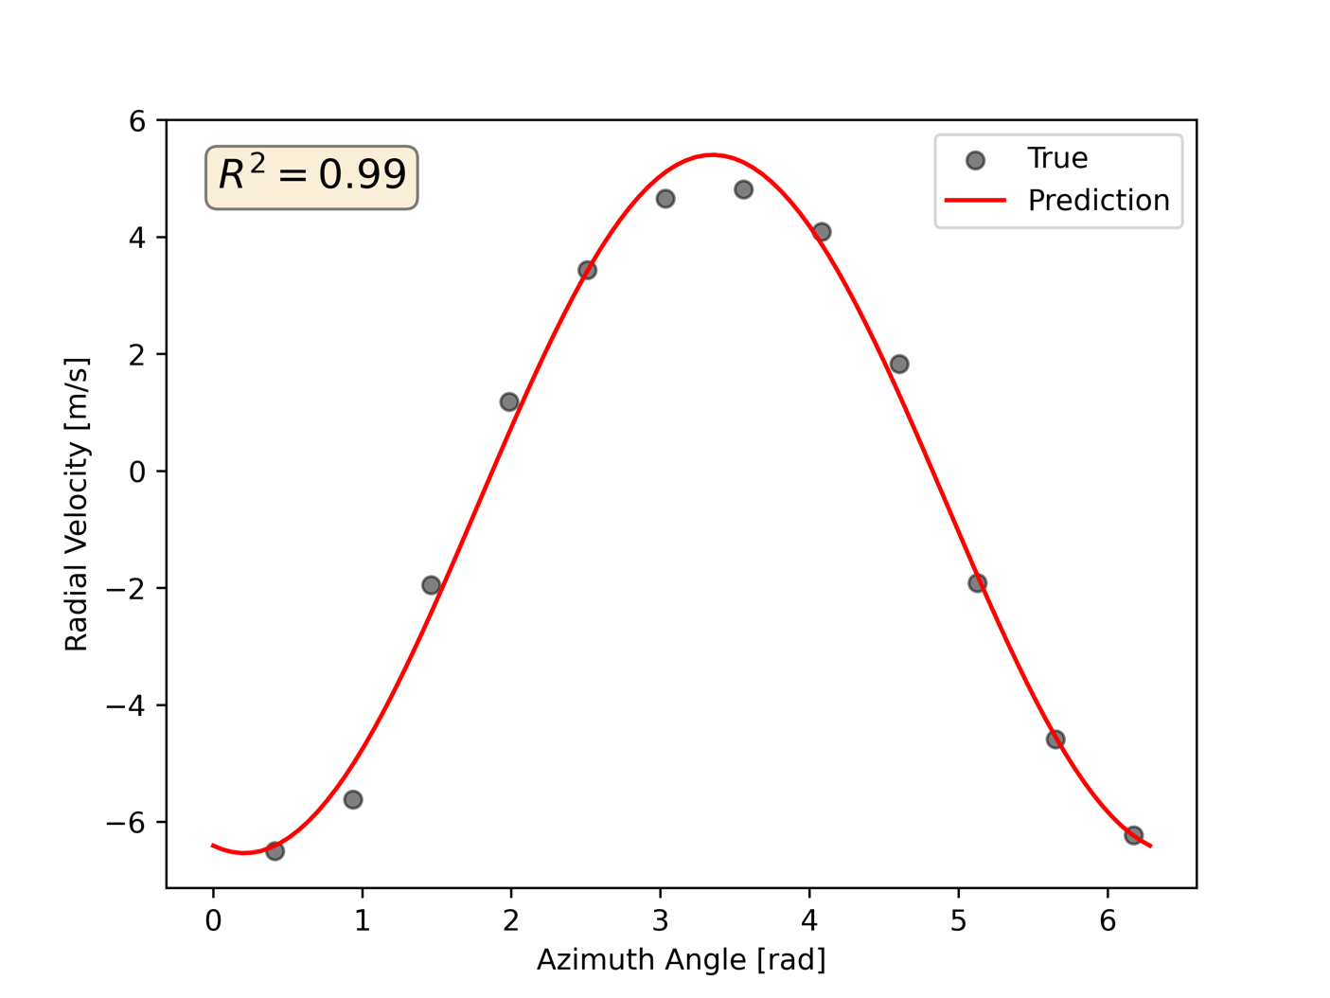
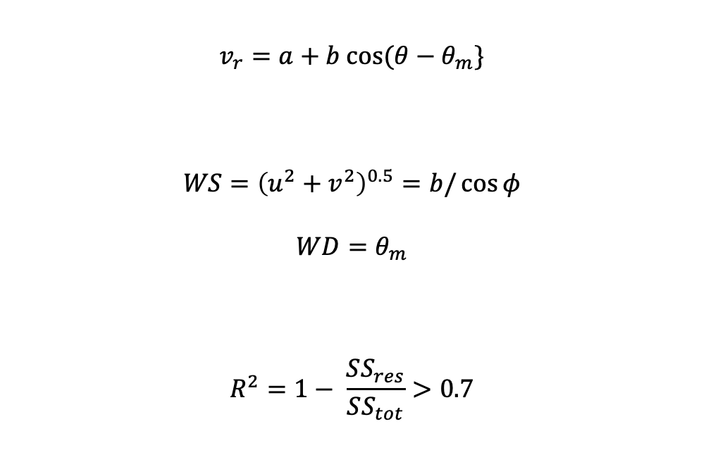
Quality control of wind speed/direction
$$v_{r}=a+b cos⁡(θ−θ_{m}\}$$
$$WS={\left(u^{2}+v^{2}\right)}^{0.5}=b/\cos{φ}$$
$$WD=θ_{m}$$
$$R^{2}=1− \frac{SS_{res}}{SS_{tot}}>0.7$$
Notes:
R^2 – 1 minus sum of squares of residuals over total sum of squares. The threshold value was empirically determined to be 0.7

Slide 8
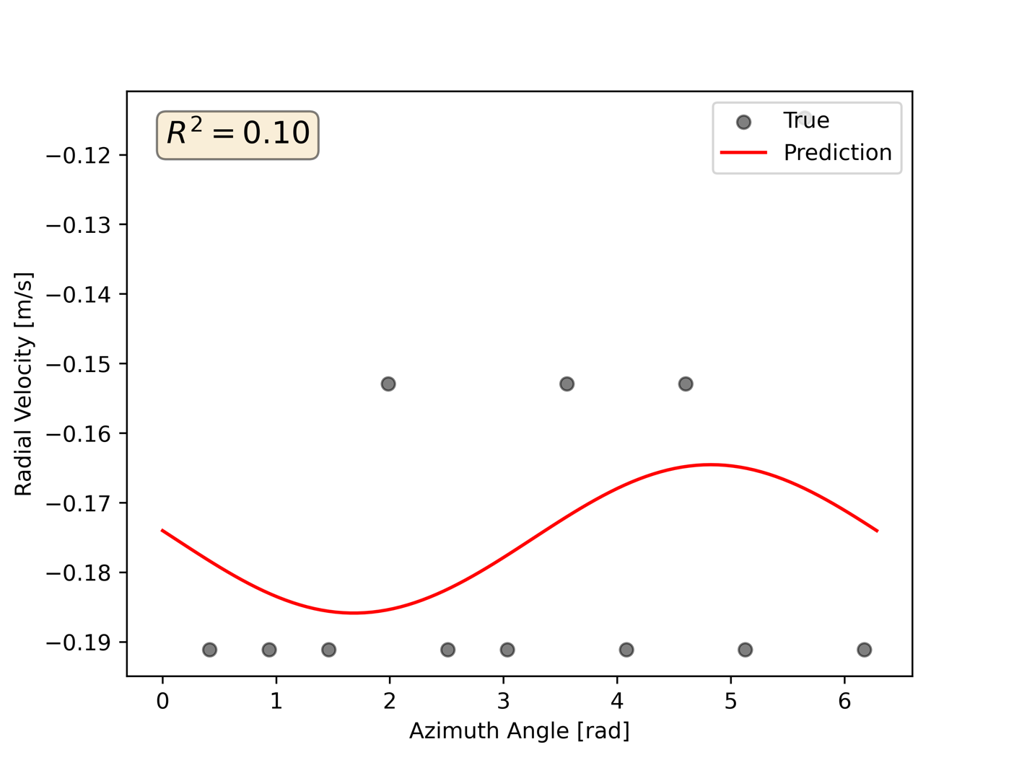
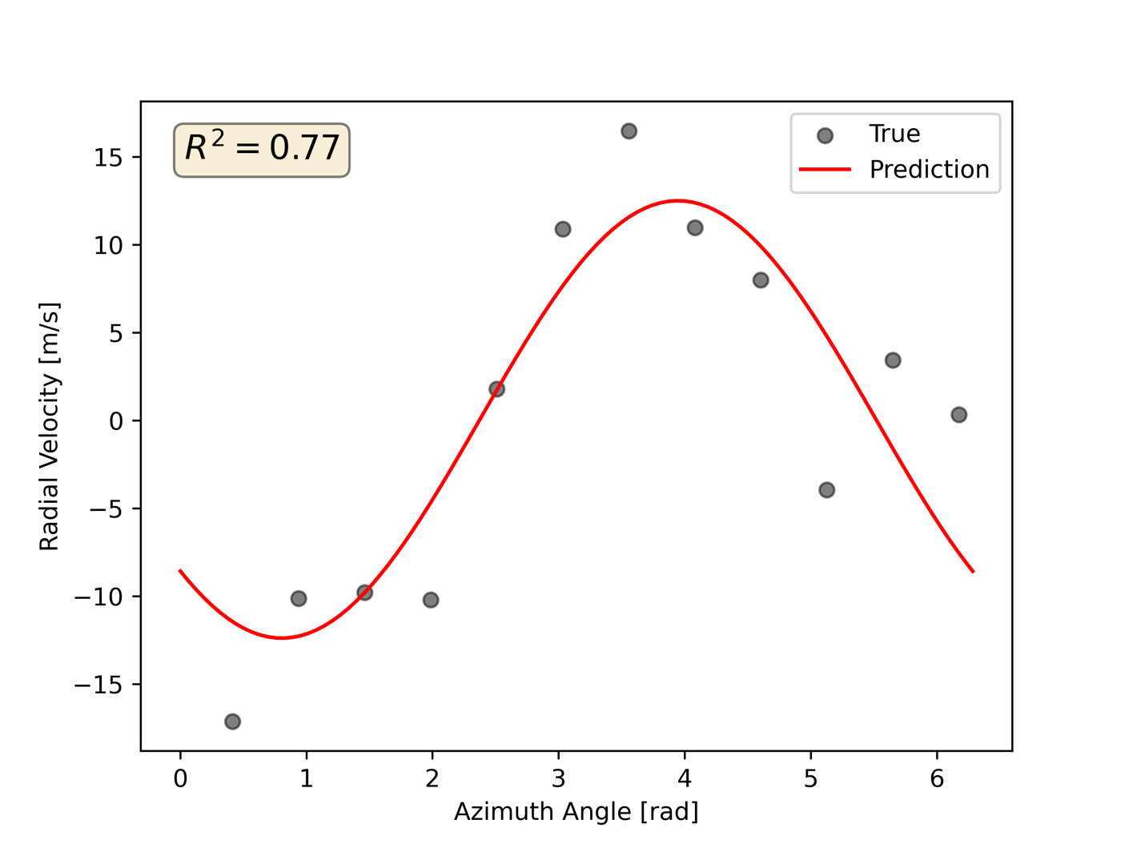
Poor
Good
Excellent!

Slide 9
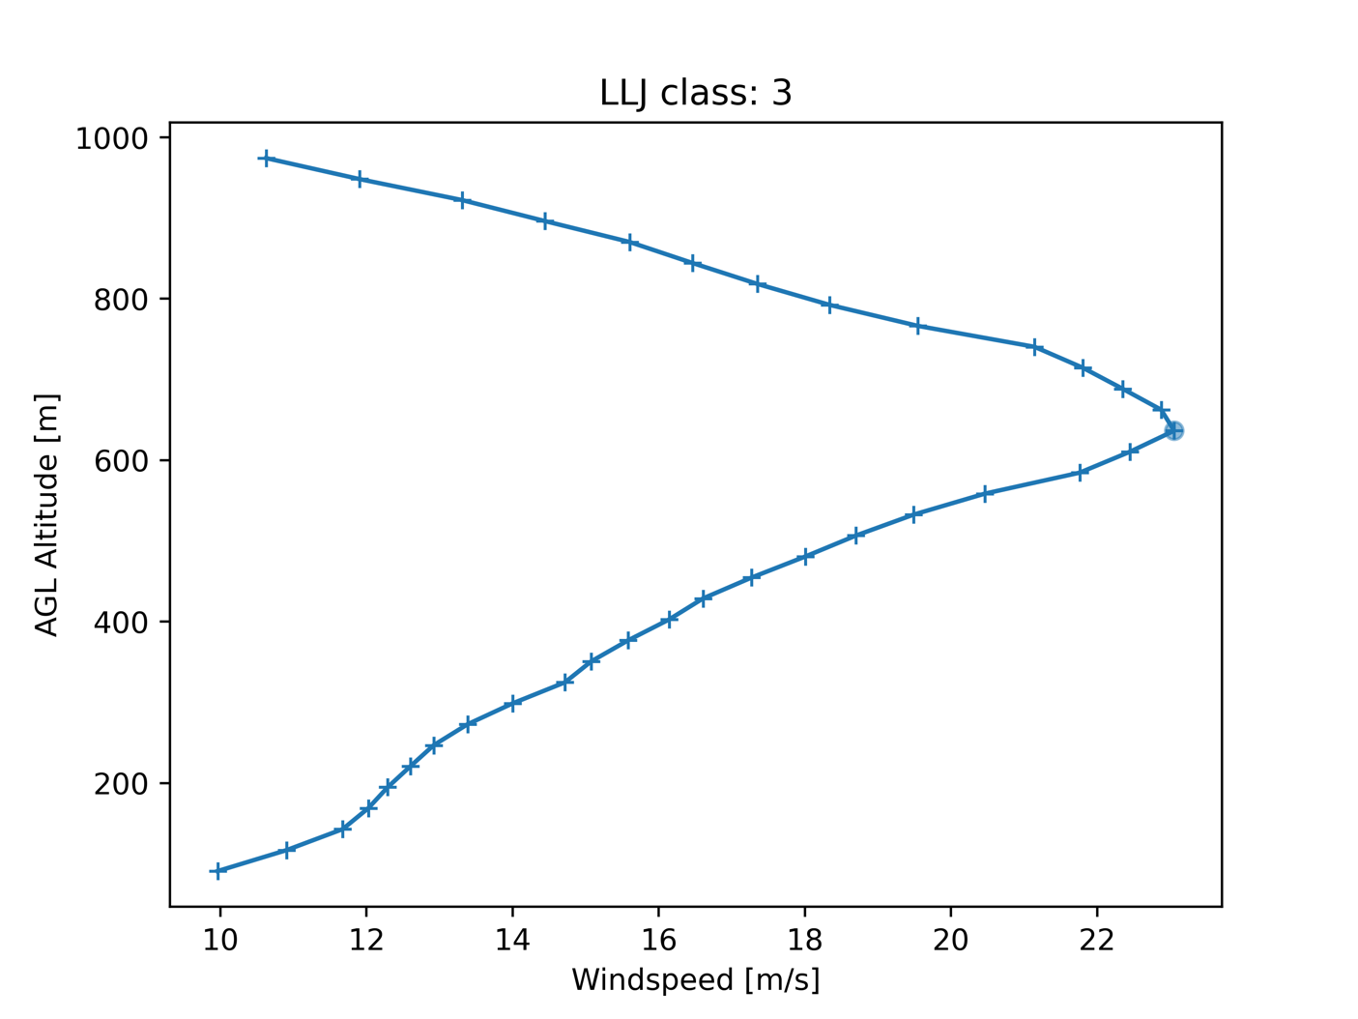
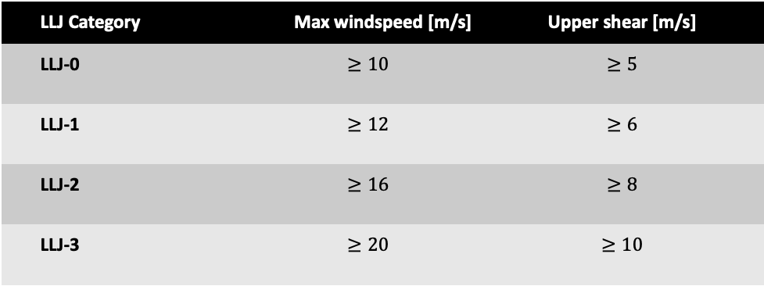
Classification Criteria
LLJ Category | Max windspeed [m/s] | Upper shear [m/s]
LLJ-0 | $$≥10$$ | $$≥5$$
LLJ-1 | $$≥12$$ | $$≥6$$
LLJ-2 | $$≥16$$ | $$≥8$$
LLJ-3 | $$≥20$$ | $$≥10$$

Slide 10
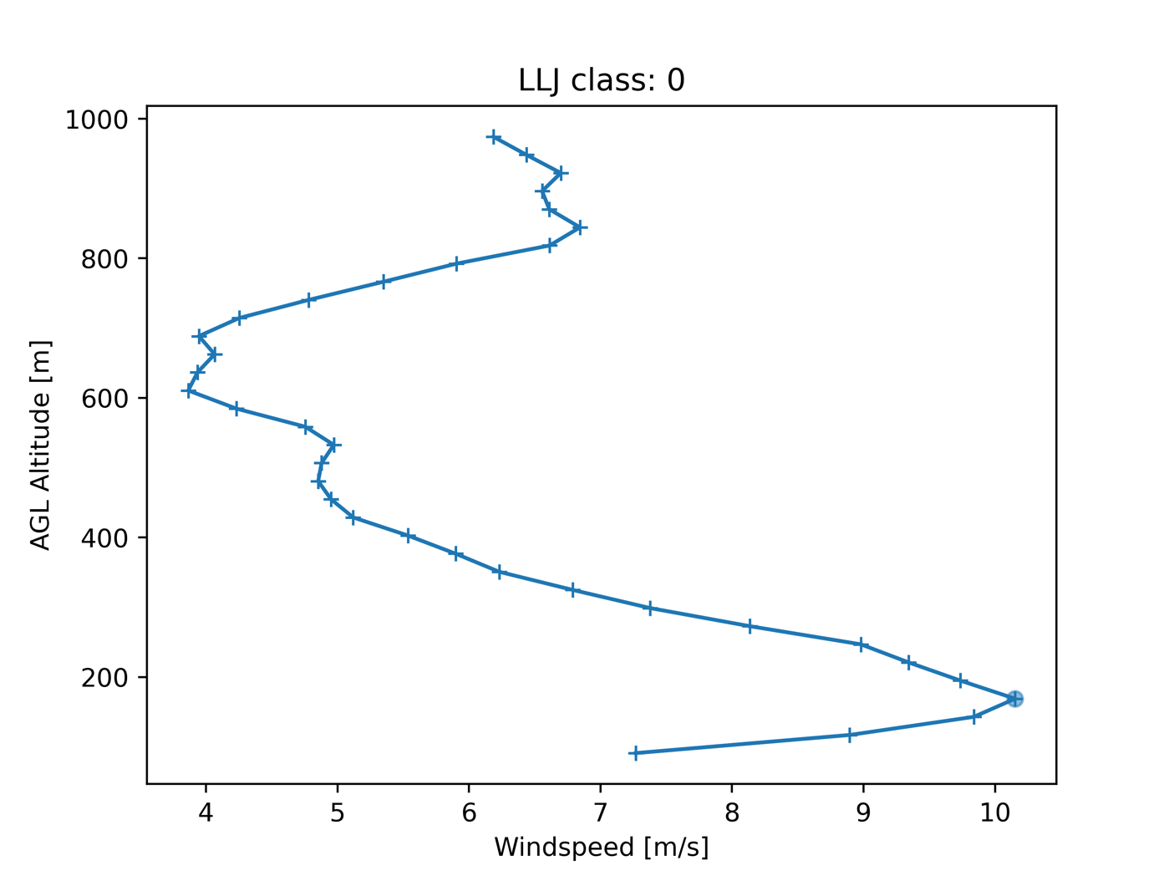
Results:

Slide 11
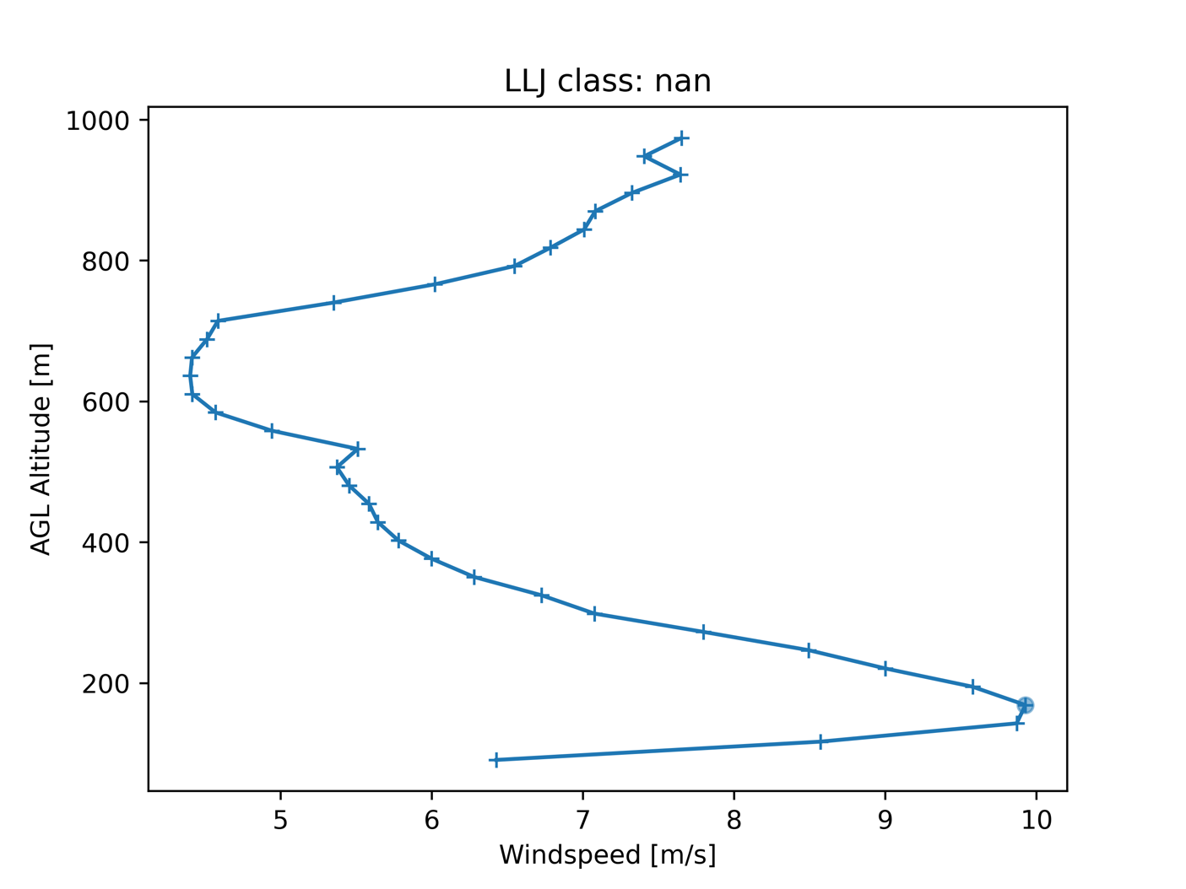
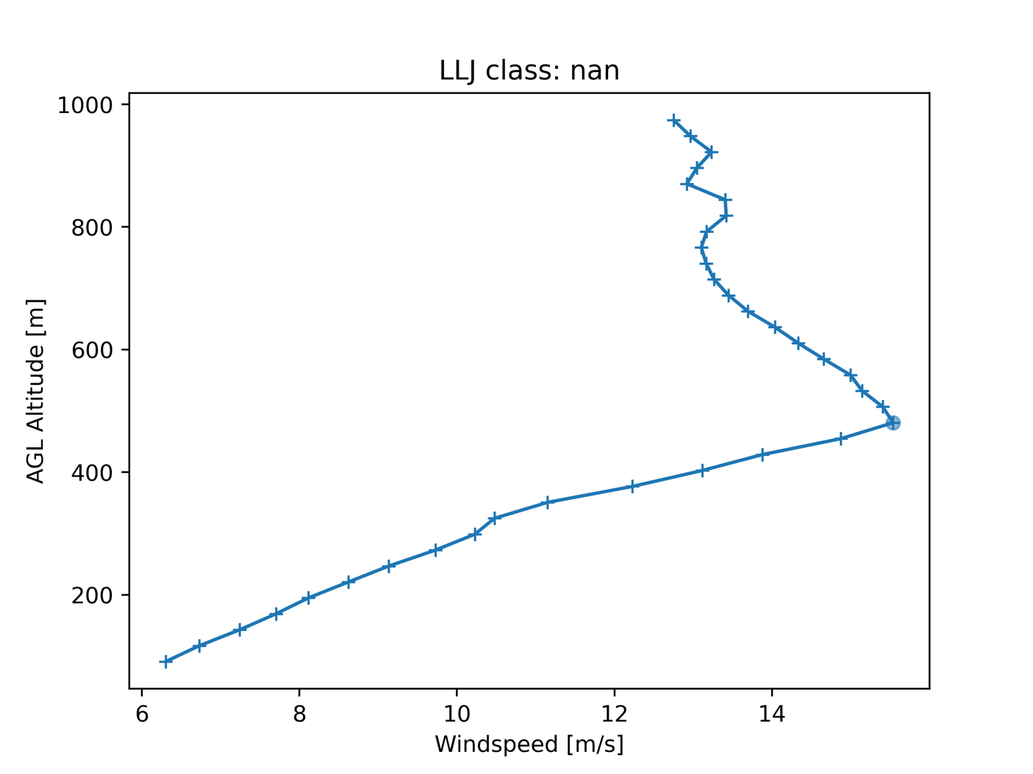
Is this method perfect?
Failed windspeed criteria
Failed shear criteria

Slide 12
Nov. 10, 2022 Event
Time (UTC) | LLJ Class | Nose Height [m] | Lower Shear [m/s] | Upper Shear [m/s] | Max. WS [m/s] | Wind Direction [deg]
2022-11-10 22:00:21 | 1 | 454.66 | 4.60 | 10.55 | 12.95 | -3.24
2022-11-10 22:30:03 | 1 | 532.61 | 3.87 | 12.08 | 15.42 | 0.71
2022-11-10 23:00:21 | 2 | 558.59 | 6.03 | 16.35 | 18.07 | 16.57
2022-11-10 23:30:03 | 2 | 558.59 | 7.50 | 15.89 | 18.58 | 14.13
2022-11-11 00:00:21 | 2 | 584.57 | 9.82 | 13.43 | 19.03 | 23.69
2022-11-11 00:30:04 | 2 | 636.53 | 8.72 | 13.16 | 19.12 | 19.98
2022-11-11 01:00:21 | 2 | 558.59 | 8.63 | 10.26 | 19.73 | 20.96
2022-11-11 01:30:04 | 3 | 610.55 | 9.72 | 10.57 | 20.89 | 19.80
2022-11-11 02:00:21 | 3 | 636.53 | 12.48 | 12.42 | 23.05 | 25.92
2022-11-11 02:30:03 | 3 | 662.51 | 12.86 | 10.72 | 22.29 | 23.65
2022-11-11 03:00:21 | 3 | 688.49 | 13.11 | 10.69 | 21.76 | 22.91
From 4pm to 11pm local time (CST)
Started as class 1, increased to class 3 by 11pm.
Northernly Wind Directions

Slide 13
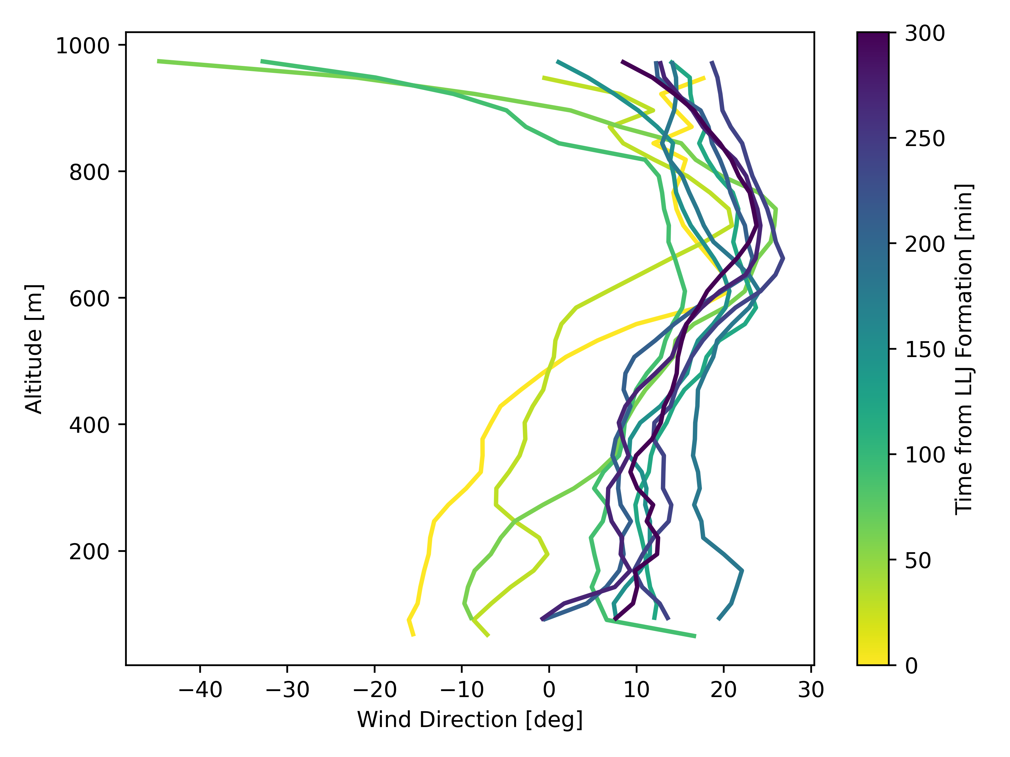
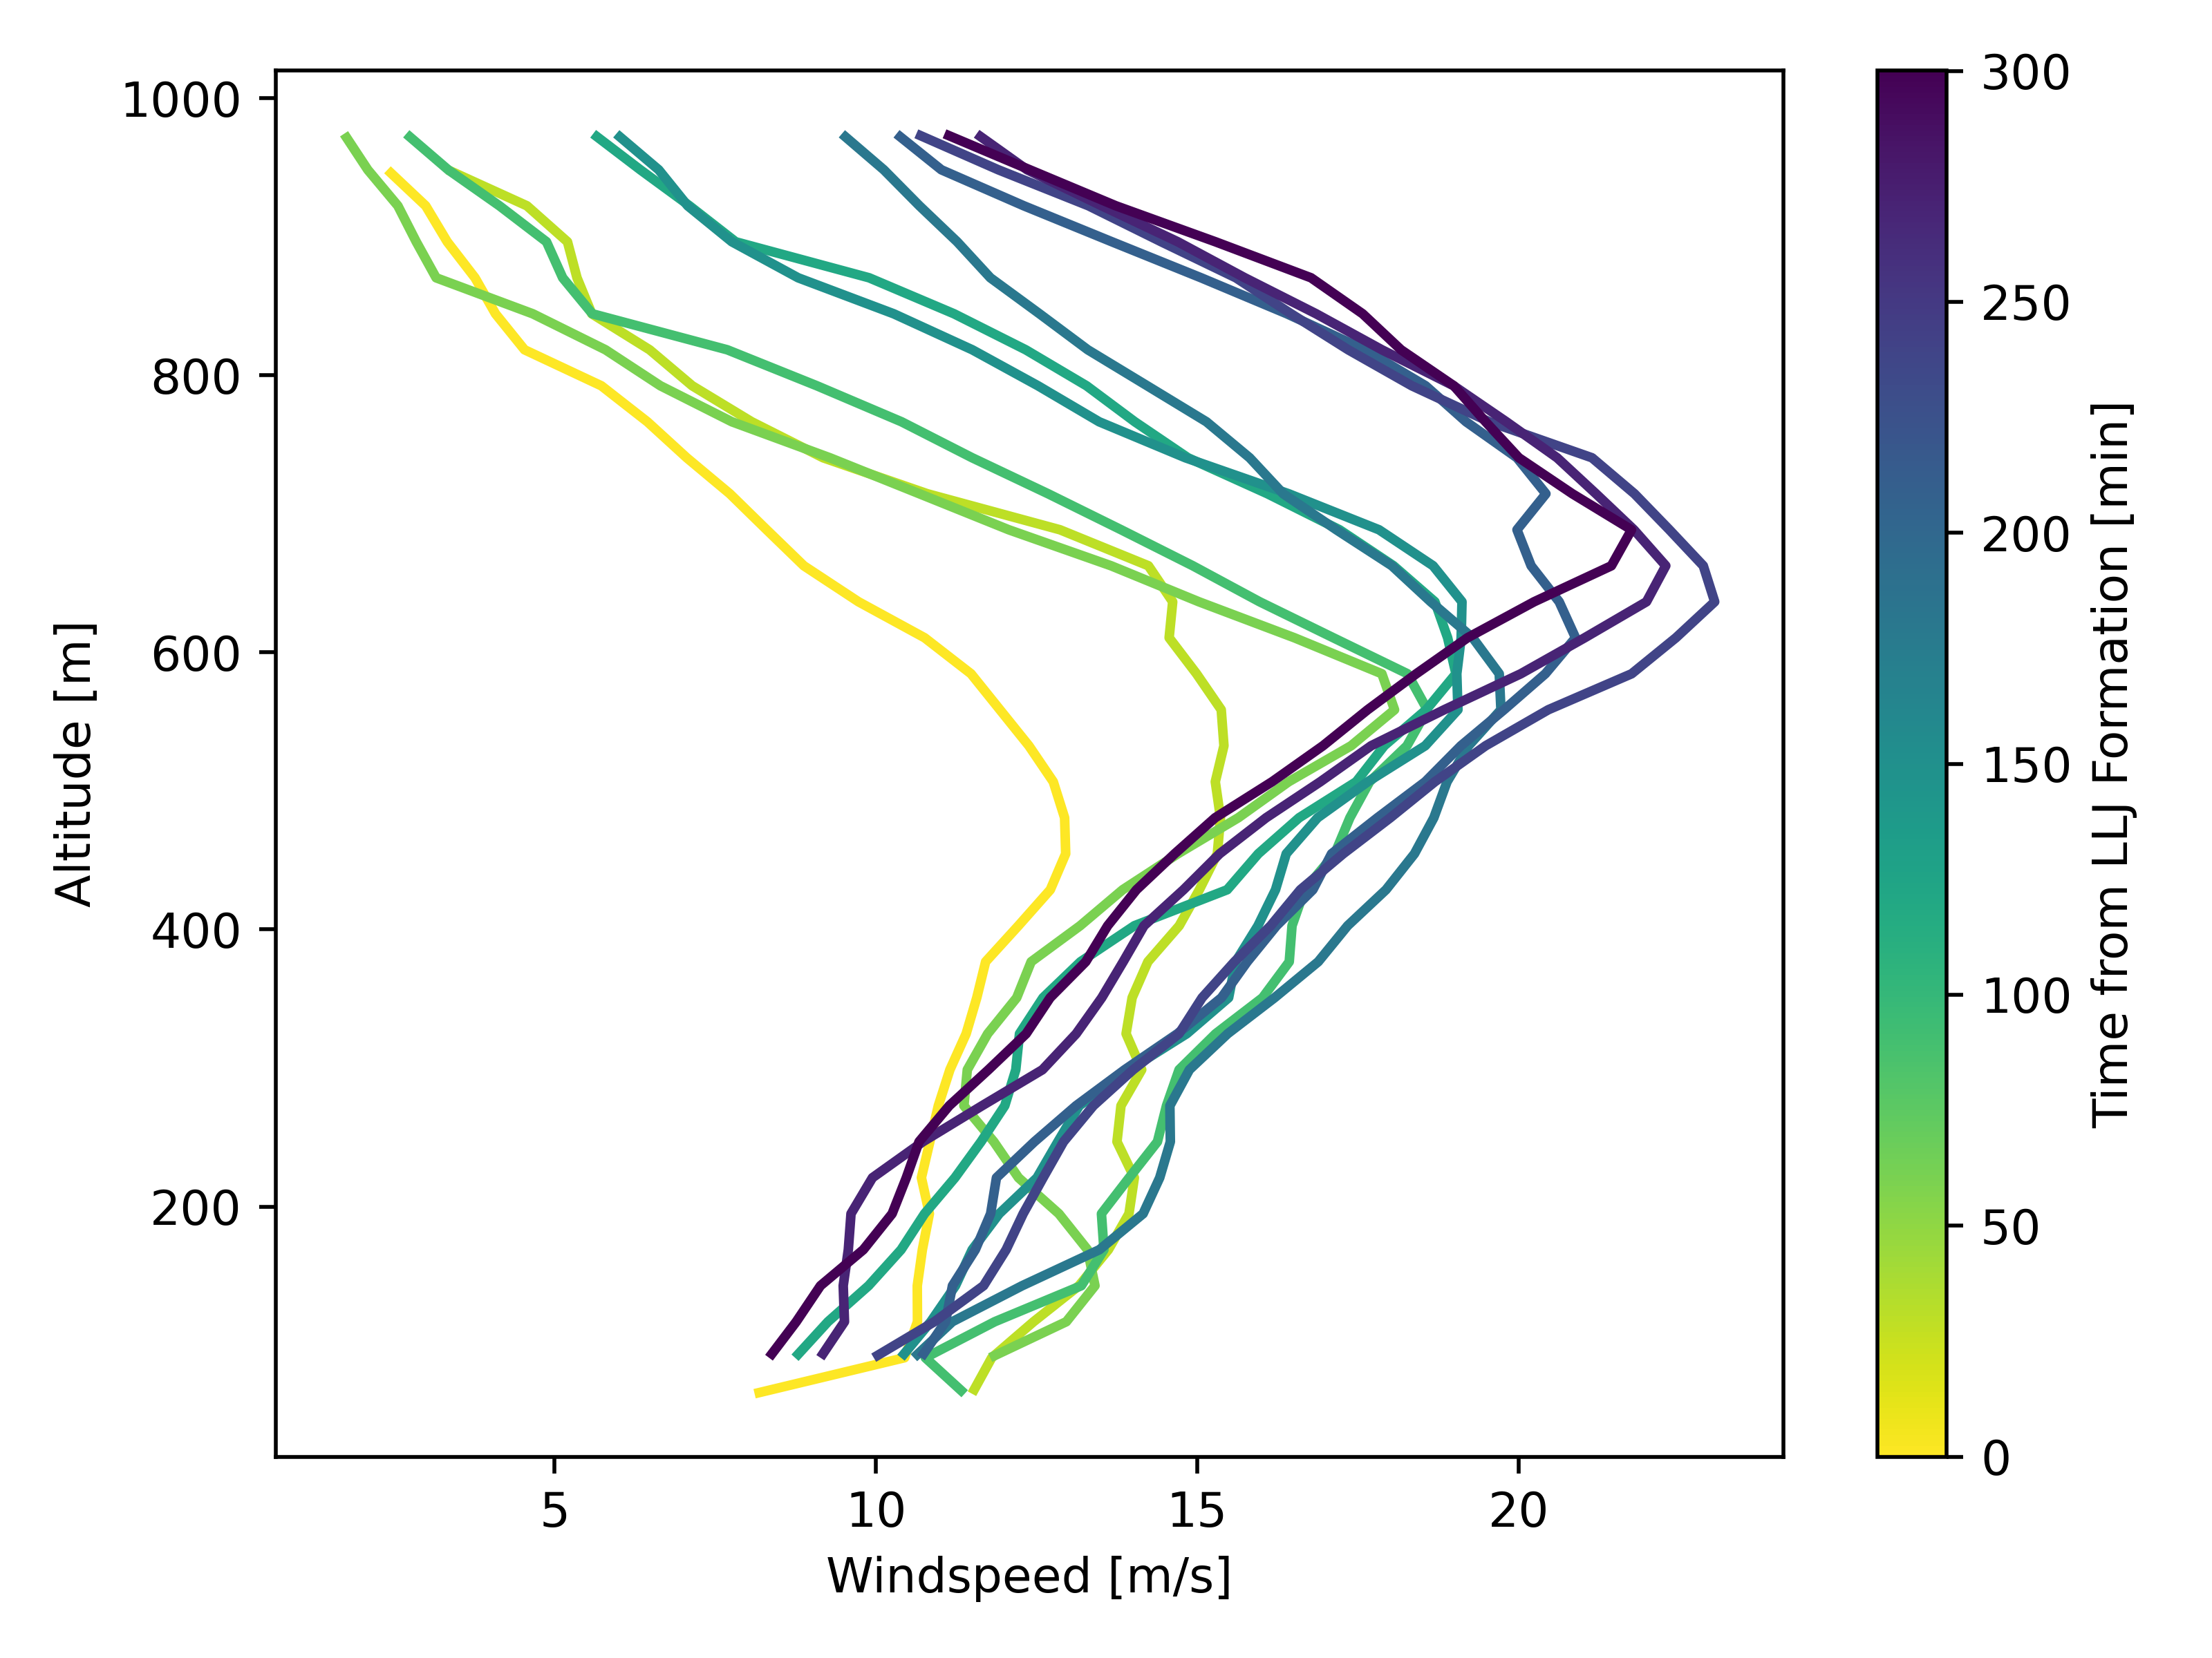
Nov. 10 2022 Event
Slight clock-wise rotation as the LLJ evolves
Increasing nose windspeed and height as LLJ evolves

Slide 14
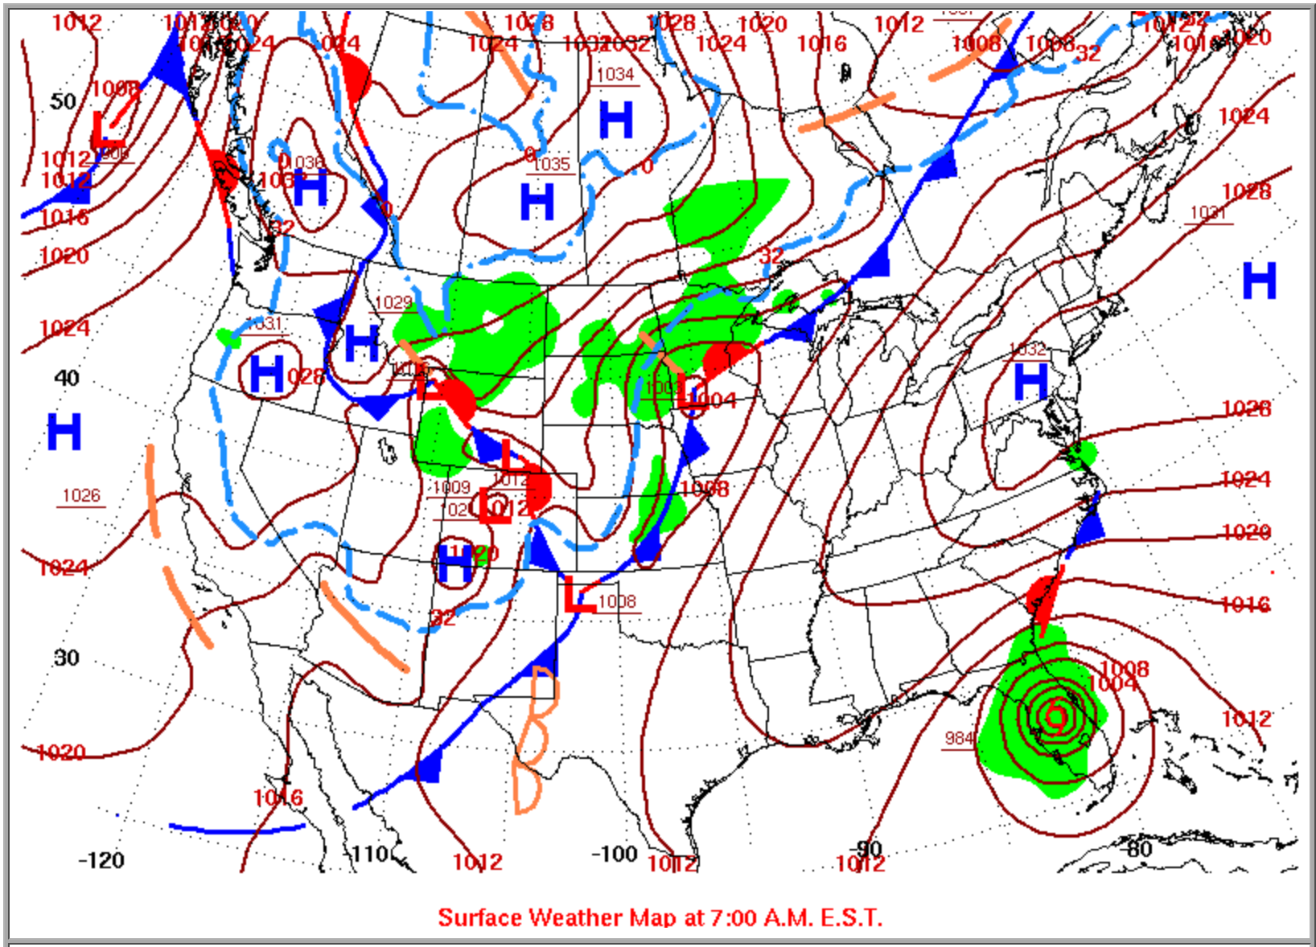
Nov. 10 Event
Northerly LLJs are found behind south-bound cold fronts in the winter, less dependent on time of day
Cold front observed moving across north-central Oklahoma during the observation period.
http://www.wpc.ncep.noaa.gov/dailywxmap/index_20221110.html

Slide 15
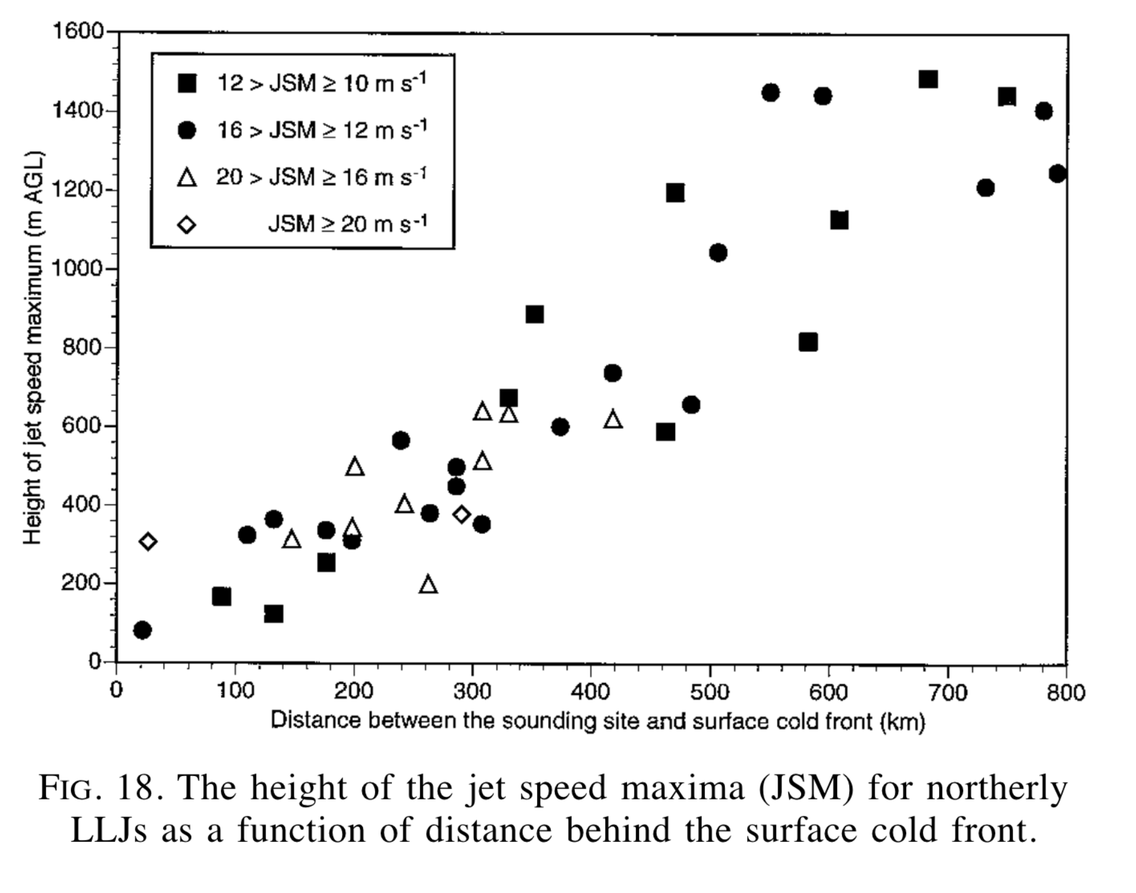
Nov. 10 Event
(Whiteman et al., 1997)

Slide 16
Nov. 13 2022 Event
Time (UTC) | LLJ Class | Nose Height [m] | Lower Shear [m/s] | Upper Shear [m/s] | Max. WS [m/s] | Wind Direction [deg]
2022-11-13 07:30:03 | 0 | 142.89 | 1.68 | 7.38 | 10.59 | 106.56
2022-11-13 08:00:21 | 0 | 168.87 | 2.57 | 6.29 | 10.15 | 116.64
2022-11-13 08:30:03 |  |  |  | 5.52 | 9.93
2022-11-13 09:00:21 | 0 | 168.87 | 3.38 | 5.55 | 10.27 | 120.19
2022-11-13 09:30:03 | 0 | 168.87 | 3.44 | 5.21 | 10.25 | 123.61
2022-11-13 10:00:20 |  |  |  | 4.63 | 9.84
2022-11-13 10:30:04 |  |  |  | 4.38 | 10.28
2022-11-13 11:00:21 |  |  |  | 4.93 | 11.02
2022-11-13 11:30:03 |  |  |  | 4.71 | 11.43
2022-11-13 12:00:21 | 0 | 168.87 | 7.90 | 5.32 | 11.95 | 128.43
From 1:30am to 6am local time (CST)
Max. windspeed and shear hovered around minimum for LLJ classification
ESE wind direction

Slide 17
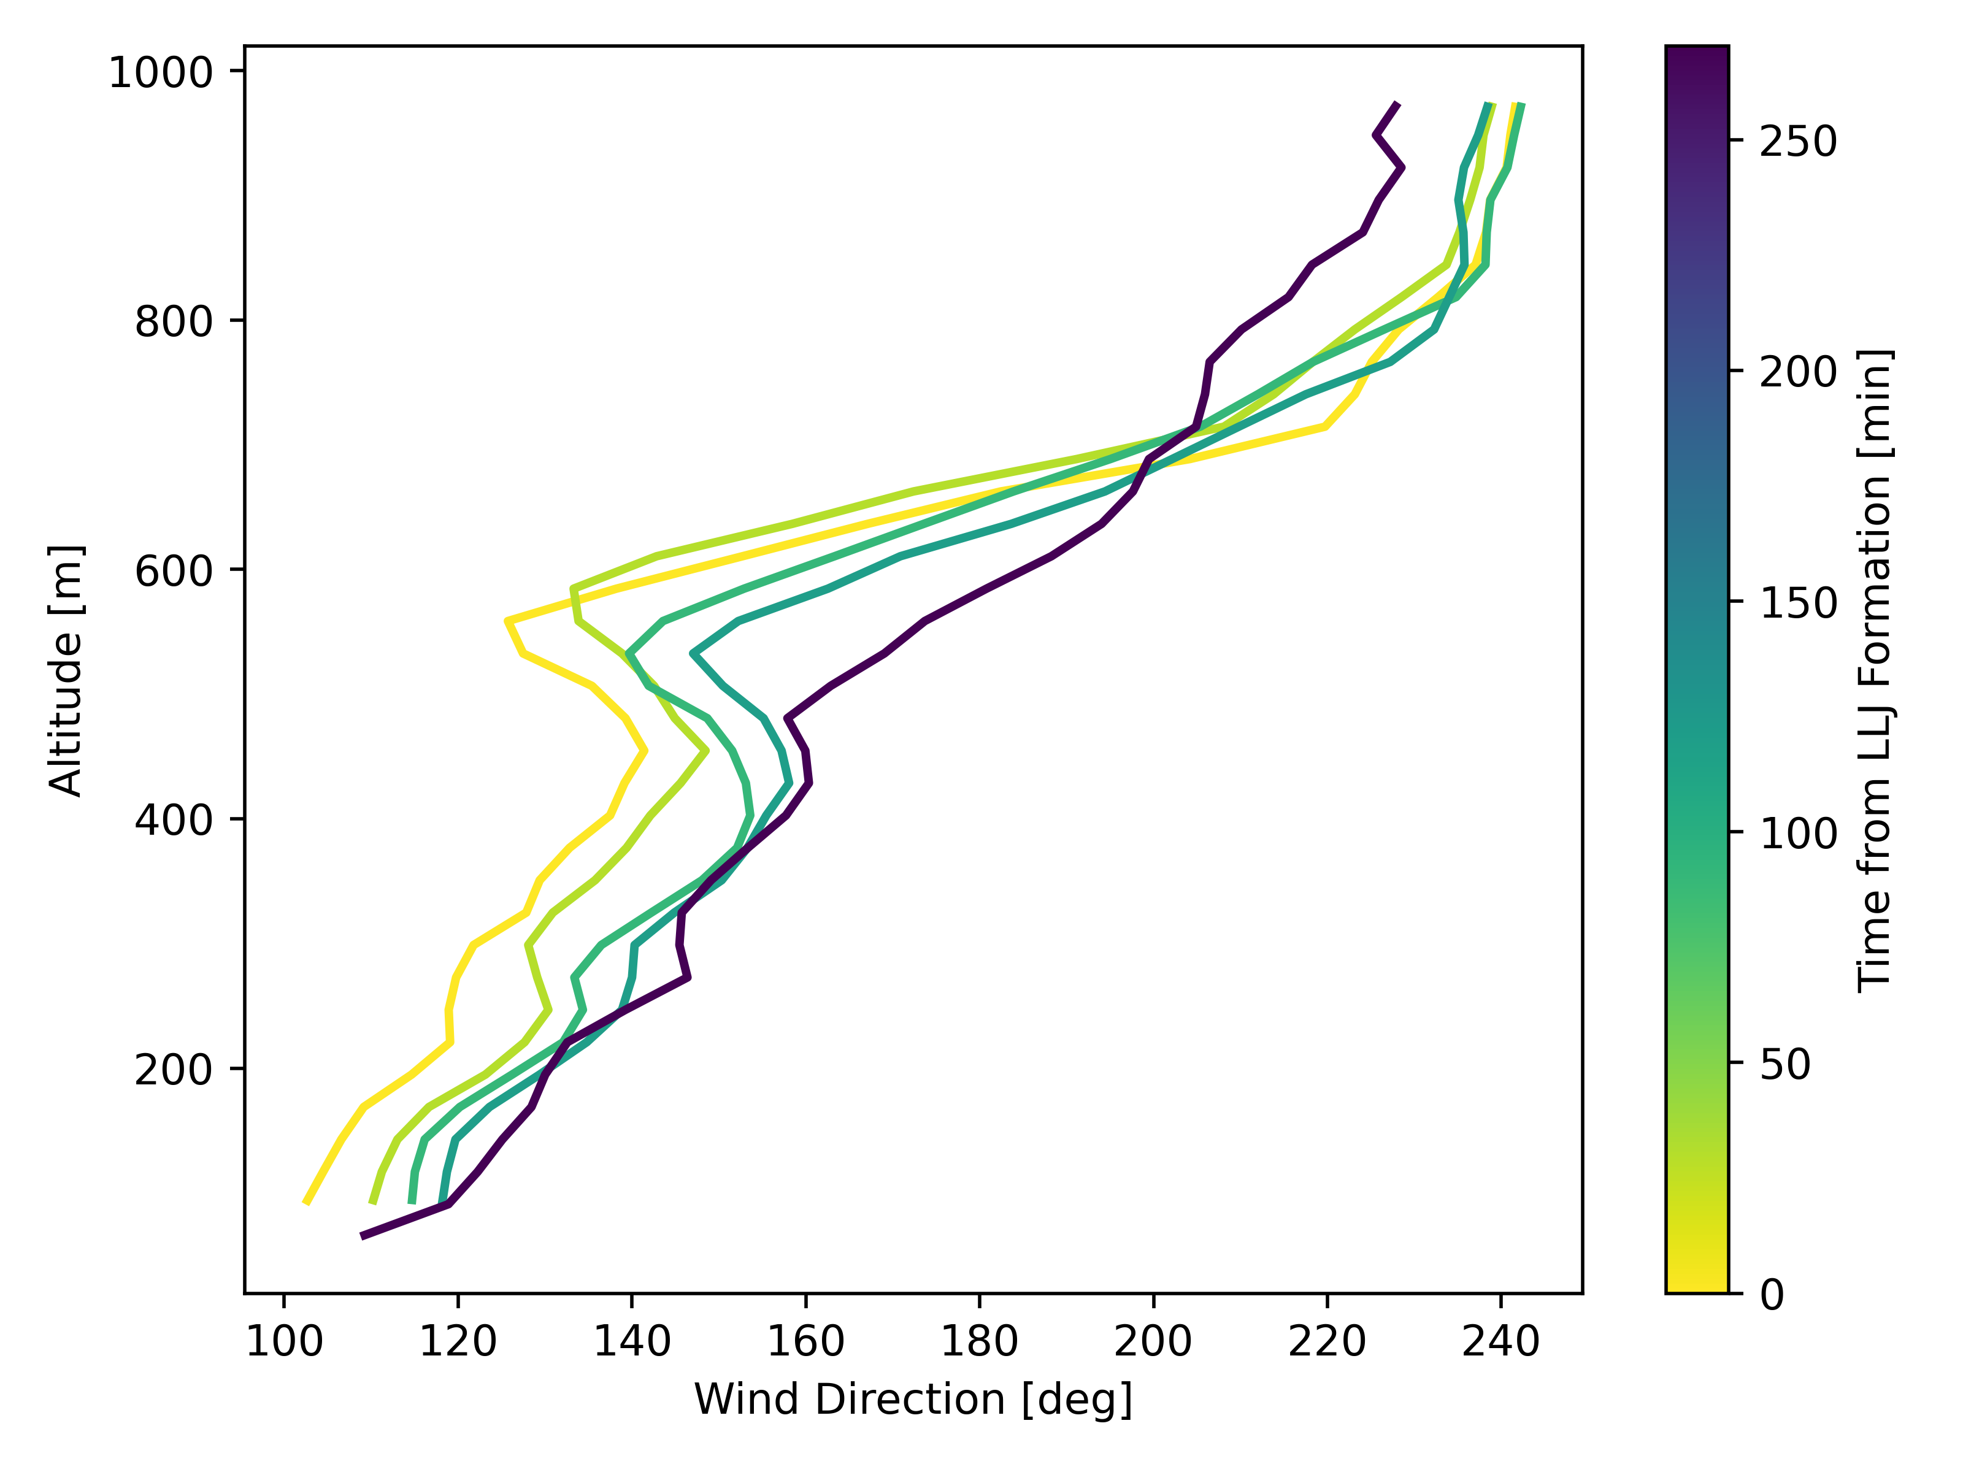
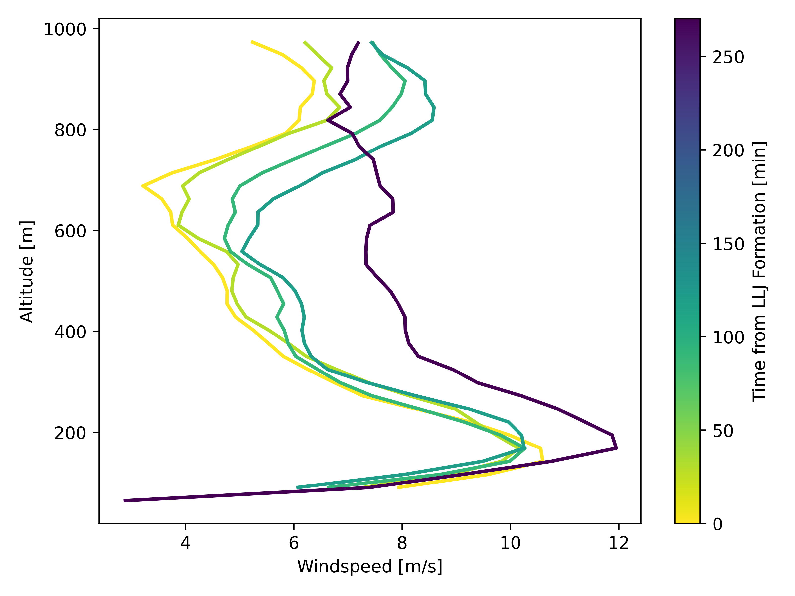
Nov. 13 2022 Event
Notes:
Left: Slight clockwise rotation, very strong wind veer
Right: Class-0 LLJ near the surface. Very strong shears. Slight oscillations observed, typical for southerly LLJs in this area.

Slide 18
Nov. 14 2022 Event
Time (UTC) | LLJ Class | Nose Height [m] | Lower Shear [m/s] | Upper Shear [m/s] | Max. WS [m/s] | Wind Direction [deg]
2022-11-14 13:00:21 | 0 | 532.61 | 5.67 | 5.54 | 13.85 | 180.74
2022-11-14 13:30:03 | 1 | 480.64 | 4.43 | 6.53 | 12.49 | 168.52
2022-11-14 14:00:21 | 1 | 532.61 | 6.17 | 6.38 | 13.42 | 175.31
From 7am to 8am local time (CST)
Evolution from LLJ-0 to LLJ-1 Classification
Southerly wind direction

Slide 19
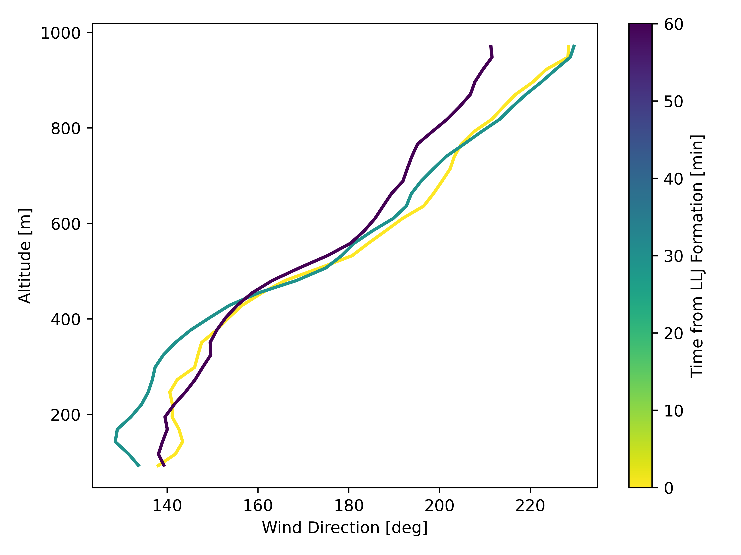
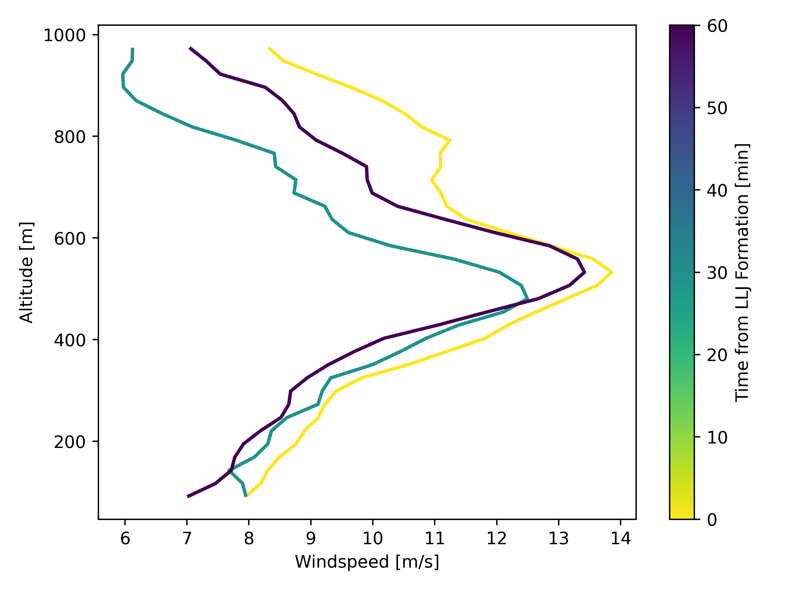
Nov. 14 2022 Event
Notes:
Left:
Very slight clockwise rotation.
Strong veer aloft, less so near the surface.
Right:
Small oscillations in windspeed – typical for southerly jets.

Slide 20

Conclusion
This work used doppler lidar data to detect and classify low-level jets using the methods presented in (Vanderwende et al., 2015).
In total, 3 LLJ events were identified at site H of the AWAKEN experiment between Nov. 9 – 17, 2022.
1 Northerly, 2 Southerly LLJs
Northerly LLJ exhibited typical characteristics of cold-weather LLJ in the area (Whiteman et al. 1997).
These LLJs were found within close proximity to the King Plains wind farm, thus will have significant impact on wind farm performance and operation.

Slide 21
Future Work
Dependence of LLJ formation and severity as a function of atmospheric stability
Comparison between observations and NWP model. Validation of NWP models used for predictive control of wind farms.
Investigate LLJ occurrence over a longer time period. Is LLJ climatology changing in the region with climate change compared to (Whiteman et al. 1997)?
Coupled study on how LLJs influence wind farm performance from SCADA data.

Slide 22
Acknowledgements
Acknowledgements: Code contributions from Daphne Quint and Prof. Julie Lundquist helped kick-start the project.
All code to recreate the results can be found on GitHub at: https://github.com/CamronAlexanderHirst/ATOC5770_LLJ

Slide 23
Bibiliography
Debnath, M., Scholbrock, A. K., Zalkind, D., Moriarty, P., Simley, E., Hamilton, N., Ivanov, C., Arthur, R. S., Barthelmie, R., Bodini, N., Brewer, A., Goldberger, L., Herges, T., Hirth, B., Valerio Iungo, G., Jager, D., Kaul, C., Klein, P., Krishnamurthy, R., … Wharton, S. (2022). Design of the American Wake Experiment (AWAKEN) field campaign. Journal of Physics: Conference Series, 2265(2), 022058. https://doi.org/10.1088/1742-6596/2265/2/022058
Vanderwende, B. J., Lundquist, J. K., Rhodes, M. E., Takle, E. S., & Irvin, S. L. (2015). Observing and Simulating the Summertime Low-Level Jet in Central Iowa. Monthly Weather Review, 143(6), 2319–2336. https://doi.org/10.1175/MWR-D-14-00325.1
Whiteman, C. D., Bian, X., & Zhong, S. (1997). Low-Level Jet Climatology from Enhanced Rawinsonde Observations at a Site in the Southern Great Plains. Journal of Applied Meteorology, 36(10), 1363–1376. https://doi.org/10.1175/1520-0450(1997)036<1363:LLJCFE>2.0.CO;2

